Slide 1
Art Education UK
National Curriculum Art KS1 – 3 (DfE, 2013) – Statutory
Primary Colours Report (Fabian Society, 2019) – Marginalisation / Subject decline
APPG for Art, Craft and Design in Education – Debate issues in Government and with Policy makers
“art, craft and design education is essential to the economy and to the cultural, spiritual, creative and social wellbeing of all; that it empowers individuals, enabling them to engage with our rich visual and cultural heritage, express themselves and become visually literate and perceptive; and that access to high quality art, craft and design education is an entitlement for everyone.” (NSEAD/ APPG, 2019)
Ofsted – New inspection framework (draft), subject reports (2009-2011), a glimmer of hope for art education
Dr Rebecca Heaton – Senior Lecturer Education (Art)
Twitter @rebeccaonart
Rebecca.Heaton@Northampton.ac.uk
Linked with INSEA

Slide 2
Art Education - University of Northampton
BA Primary Education 5-11 - Year 1 10 hours, Year 2 10 hours
PGCE Primary Education 3-7 & 5-11 - 2 hours + LOC Experience
BA Primary Content | Y1 National School Pupil Knowledge, skills, understanding Partnership/ collaboration | Y2 LOC – local/ national MTP CC/ thematic learning Subject leadership
PGCE Content | Practical workshop carousel – skill development Subject awareness – National, school, pupil Arts-based research
CPD/ Research projects/Exhibitions/ Outreach - Northampton Inspire, DLAB, Wider Curriculum Research, Social Justice Art Education Exhibitions, SEND/Art projects in schools
Partnerships – Local/ National/ International Schools, Charities, Galleries & Museums, Arts Organisations

Slide 3
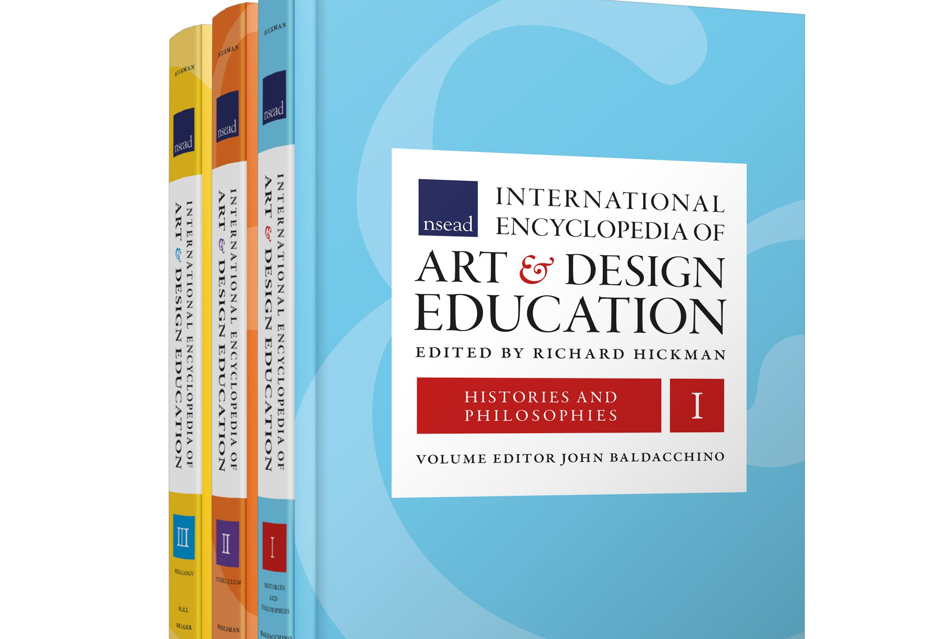
Research/ Publications - Dr Rebecca Heaton
Heaton, R. (2018). Autoethnography to artography: An exhibition of cognition in artist teacher practice (Doctoral thesis – Cambridge University). https://doi.org/10.17863/CAM.33324
INSEA Doctoral Research Award (2019)
Heaton, R. (2018). Artist teacher cognition: connecting ‘self’ with ‘other.’ Australian Journal of Art Education, 39(1), 139-145. Visual essay.
Heaton, R. and Crumpler, A. (2017). Sharing mindfulness: A moral practice for artist teachers. International Journal of Education & the Arts, 18(26). Retrieved from http://www.ijea.org/v18n26/.
Heaton, R. (2019). Digital art pedagogy in the United Kingdom. In R. Hickman, K. Freedman, E. Hall & N. Meager (Eds.), International encyclopedia of art and design education. London: Sage. https://doi.org/10.1002/9781118978061.ead003

